Slide 1
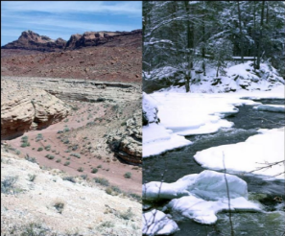
Hot and Cold.

Slide 2






Click to see What places can be hot or cold?
cloth

Slide 3
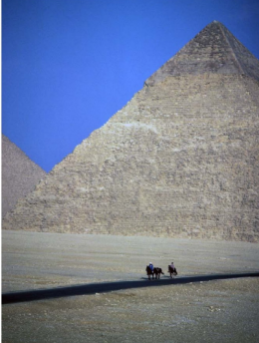
A place can be hot.
return
return
return
return

Slide 4
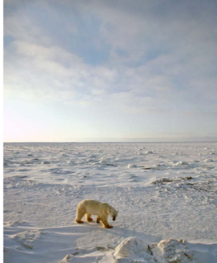
A place can be cold.
return

Slide 5
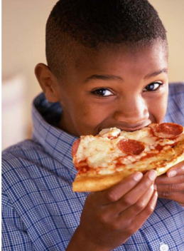
Food can be hot.
return

Slide 6
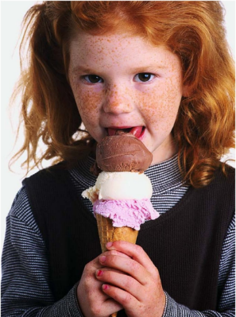
Food can be cold.
return

Slide 7
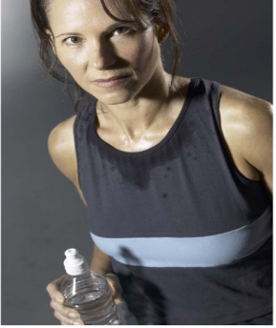
People can be hot.
return

Slide 8
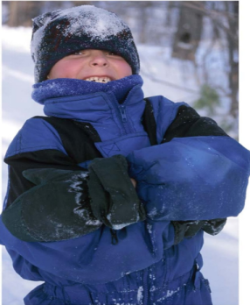
People can be cold.
return

